Slide 1
Introduction to Mobile Robots Localization
Baul Xu
27/8/2019

Slide 2


Slide 3
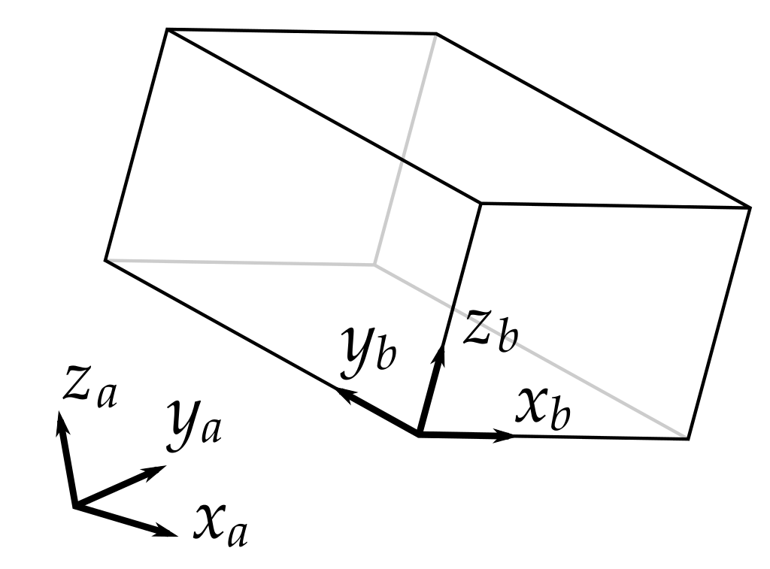

Coordinate System
6D pose in 3D Space
Rx--Roll
$$\left[\begin{matrix}x \\ y \\ \begin{matrix}z \\ Rx \\ \begin{matrix}Ry \\ Rz\end{matrix}\end{matrix}\end{matrix}\right]$$
Ry--Pitch
Rz--Yaw

Slide 4





Coordinate System
Pose of Mobile Robots
$$y_{b}$$
$$y_{a}$$
$$\left[\begin{matrix}x \\ y \\ Rz\end{matrix}\right]$$
Rz--Yaw
$$x_{b}$$
$$x_{a}$$

Slide 5






Coordinate System
Coordinate System of Mobile Robots
World
Odom
Base_link
$$y_{w}$$
$$y_{R}$$
$$x_{R}$$
$$y_{odom}$$
$$x_{odom}$$
$$x_{w}$$

Slide 6
The Basic Principle of Localization
Relative Localization
Global Localization

Slide 7






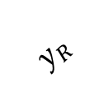

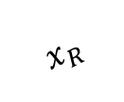
The Basic Principle of Localization
Relative Localization
Dead Reckoning
Continous localization
× Accumulated error
$$y_{odom}$$
$$y_{R}$$
$$x_{R}$$
$$y$$
$$θ$$
$$y_{R}$$
$$x_{R}$$
$$x$$
$$x_{odom}$$

Slide 8
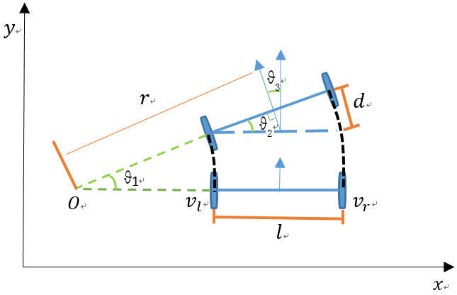

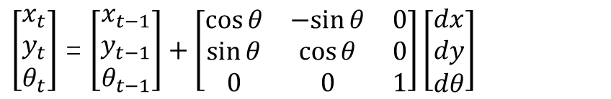
The Basic Principle of Localization
Relative Localization
Dead Reckoning
Ideal model:
$$v_{l}=w_{l}D$$
$$v_{r}=w_{r}D$$
$$v=\frac{v_{l}+v_{r}}{2}$$
$$w=\frac{v_{r}−v_{l}}{l}$$
$r=\frac{v}{w}$=$\frac{l\left(v_{l}+v_{r}\right)}{2\left(v_{r}−v_{l}\right)}$
$\left[\begin{matrix}x_{t} \\ y_{t} \\ θ_{t}\end{matrix}\right]$ = $\left[\begin{matrix}x_{t−1} \\ y_{t−1} \\ θ_{t−1}\end{matrix}\right]+\left[\begin{matrix}\cos{θ} & −sin{θ} & 0 \\ \sin{θ} & \cos{θ} & 0 \\ 0 & 0 & 1\end{matrix}\right]\left[\begin{matrix}dx \\ dy \\ dθ\end{matrix}\right]$

Slide 9







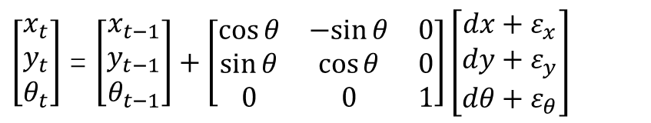
The Basic Principle of Localization
Relative Localization
Dead Reckoning
Error model:
$$y_{odom}$$
Real pose
$${ v}_{l}=w_{l}\left(D+ε\right)$$
$${ v}_{r}=w_{r}\left(D+ε\right)$$
$$v=\frac{v_{l}+v_{r}}{2}$$
$$w=\frac{v_{r}−v_{l}}{\left(l+ε\right)}$$
$r=\frac{v}{w}$=$\frac{l\left(v_{l}+v_{r}\right)}{2\left(v_{r}−v_{l}\right)}$
$$y$$
Pose in ‘mind’
$$y_{R}$$
$$x_{R}$$
$$x$$
$$x_{odom}$$
$\left[\begin{matrix}x_{t} \\ y_{t} \\ θ_{t}\end{matrix}\right]$ = $\left[\begin{matrix}x_{t−1} \\ y_{t−1} \\ θ_{t−1}\end{matrix}\right]+\left[\begin{matrix}\cos{θ} & −sin{θ} & 0 \\ \sin{θ} & \cos{θ} & 0 \\ 0 & 0 & 1\end{matrix}\right]\left[\begin{matrix}dx+ε_{x} \\ dy+ε_{y} \\ dθ+ε_{θ}\end{matrix}\right]$

Slide 10
The Basic Principle of Localization
Global Localization
QR code
MCL
GPS
RFID
…

Slide 11








The Basic Principle of Localization
Global Localization
No cumulative error
× Discontinuity
× Local minimum problem
$$l_{1}$$
$$l_{2}$$
$$y_{w}$$
$$\left(d,θ\right)$$
$$\left(d,θ\right)$$
Do you think which one is the true pose?
$$p_{0}$$
$$p_{1}$$
$$x_{w}$$

Slide 12




The Basic Principle of Localization
Global Localization
$$l_{1}$$
$$l_{2}$$
$$y_{w}$$
Relative localization
$$l_{0}$$
$$l_{4}$$
$$l_{3}$$
$$x_{w}$$

Slide 13
The Basic Principle of Localization
Global Localization
odom
Pose
z
$$l_{1}$$
$$l_{2}$$
$$y_{w}$$
Relative localization
$$l_{0}$$
$$l_{4}$$
$$l_{3}$$
$$x_{w}$$

Slide 14
Thank you

